Slide 1






$$qevap$$
$$qin$$
?
1
2
$$ΔS$$
?
$$qdiv$$
$$qimp$$
4
?
Reservoir
$$qout$$
Gauge
3

Slide 2

We are here!
Total apriori ignorance
Total apriori knowledge
Statistical
Lumped Integral
Distributed Integral
Distributed Differential
purely stochastic
causal

Slide 3
Total apriori ignorance
Total apriori knowledge
Statistical
Lumped Integral
Distributed Integral
Distributed Differential
purely stochastic
causal

Slide 4
Chapter 2
& 5
Data Transformations
Find, collect, explore (i.e., summarize and visualize), pre-process variables (i.e., cleaning, formatting, and sampling), transform data (i.e., scaling, decomposition, and aggregation), impute, engineer, select, and encode features, build datasets.
Chapter 3
Loss Function
Develop a suitable measure of model fit.
Chapter 4
Sampling Method
Identify and develop sampling methods suited to the question and structures present in the data. Sampling methods are used to determine a model’s hyper-parameters or estimate a model’s prediction error.
All
Model Development
Select algorithm based on question, data, and computational ability. Use an appropriate method to optimize the loss or objective function (e.g., gradient decent, evolutionary algorithms.
All
Results & Benchmarking
Analyze the results. Evaluate time to obtain results.
If needed, perform more tuning, apply ensemble methods (bagging, boosting, blending), or implement extreme feature engineering. Check if you have appropriate infrastructure, scaling capabilities of the infrastructure, and permissions/access to the algorithm.
Chapter 6
Improvements
Deployment & Operationalization
Plan for feature manipulation for training and inference in real time, training the algorithm periodically, deployment into production, integration with other systems.
Societal Impacts
Track societal impacts and mitigate harm.

Slide 5




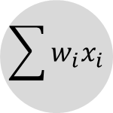













propagation
function
activation
function
input
layer
hidden
layer
output
layer
inputs
weights
outputs
$$x_{1}$$
$${ w}_{1j}$$
$$\sum{w_{i}x_{i}}$$
$${net}_{j}$$
$$x_{2}$$
$${ w}_{2j}$$
$$φ$$
$$y_{j}$$
$$x_{1}$$
$$y_{1}$$
activation
$$x_{3}$$
$${ w}_{3j}$$
neuron
$$θ_{j}$$
$$x_{2}$$
.
.
.
threshold
.
.
.
.
.
.
.
.
.
$$y_{n}$$
$$x_{n}$$
$${ w}_{nj}$$
$$x_{n}$$

Slide 6





Observed
Predicted 1
$$y^{′′}>0$$
Predicted 2
Low Cost
High Cost
$$y$$
$$y^{′′}=0$$
High Cost
$$y^{′′}<0$$
Low Cost
$$time$$

Slide 7

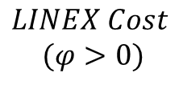

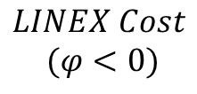


$$LINEX Cost$$
$$(φ>0)$$
Low Cost
Under Predicting
High
Cost
Over
Predicting
$$y$$
$$y_{sim−}y_{obs}$$
$$LINEX Cost$$
$$(φ<0)$$
Low Cost
Over Predicting
High
Cost
Under Predicting
$$y_{sim−}y_{obs}$$
$$time$$

Slide 8




Observed
Predicted 1
Predicted 2
Worse
Fewer Extreme Events
$$Probability Density Function (PDF)$$
Bad
Off From Observed
But Conservative
High
Cost
RSD < 1
$$cost$$
Low Cost
RSD >1
1
$${RSD= SD(y}_{sim})/SD(y_{obs})$$
$$y$$

Slide 9




$$Flood$$
$$Drought$$
$$cost$$
$$cost$$
High
Cost
Under Predicting
High
Cost
Over
Predicting
Low Cost
Over Predicting
Low Cost
Under Predicting
α
β
β
α
$$y_{sim−}y_{obs}$$
$$y_{sim−}y_{obs}$$

Slide 10
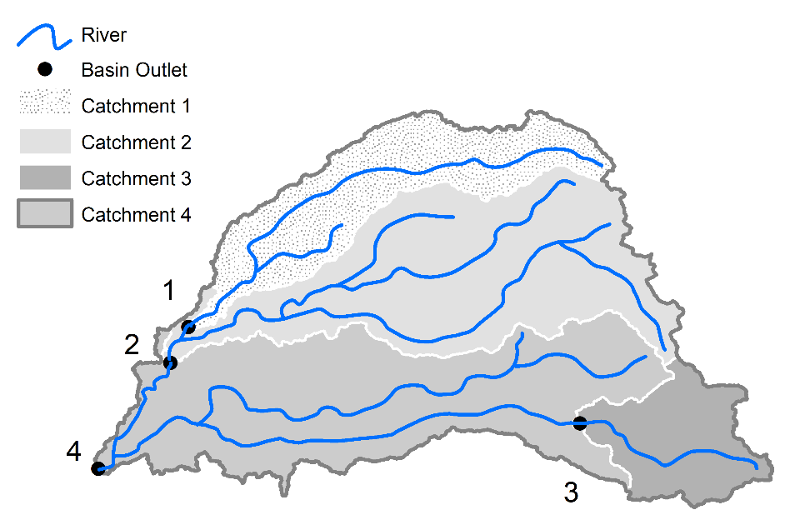
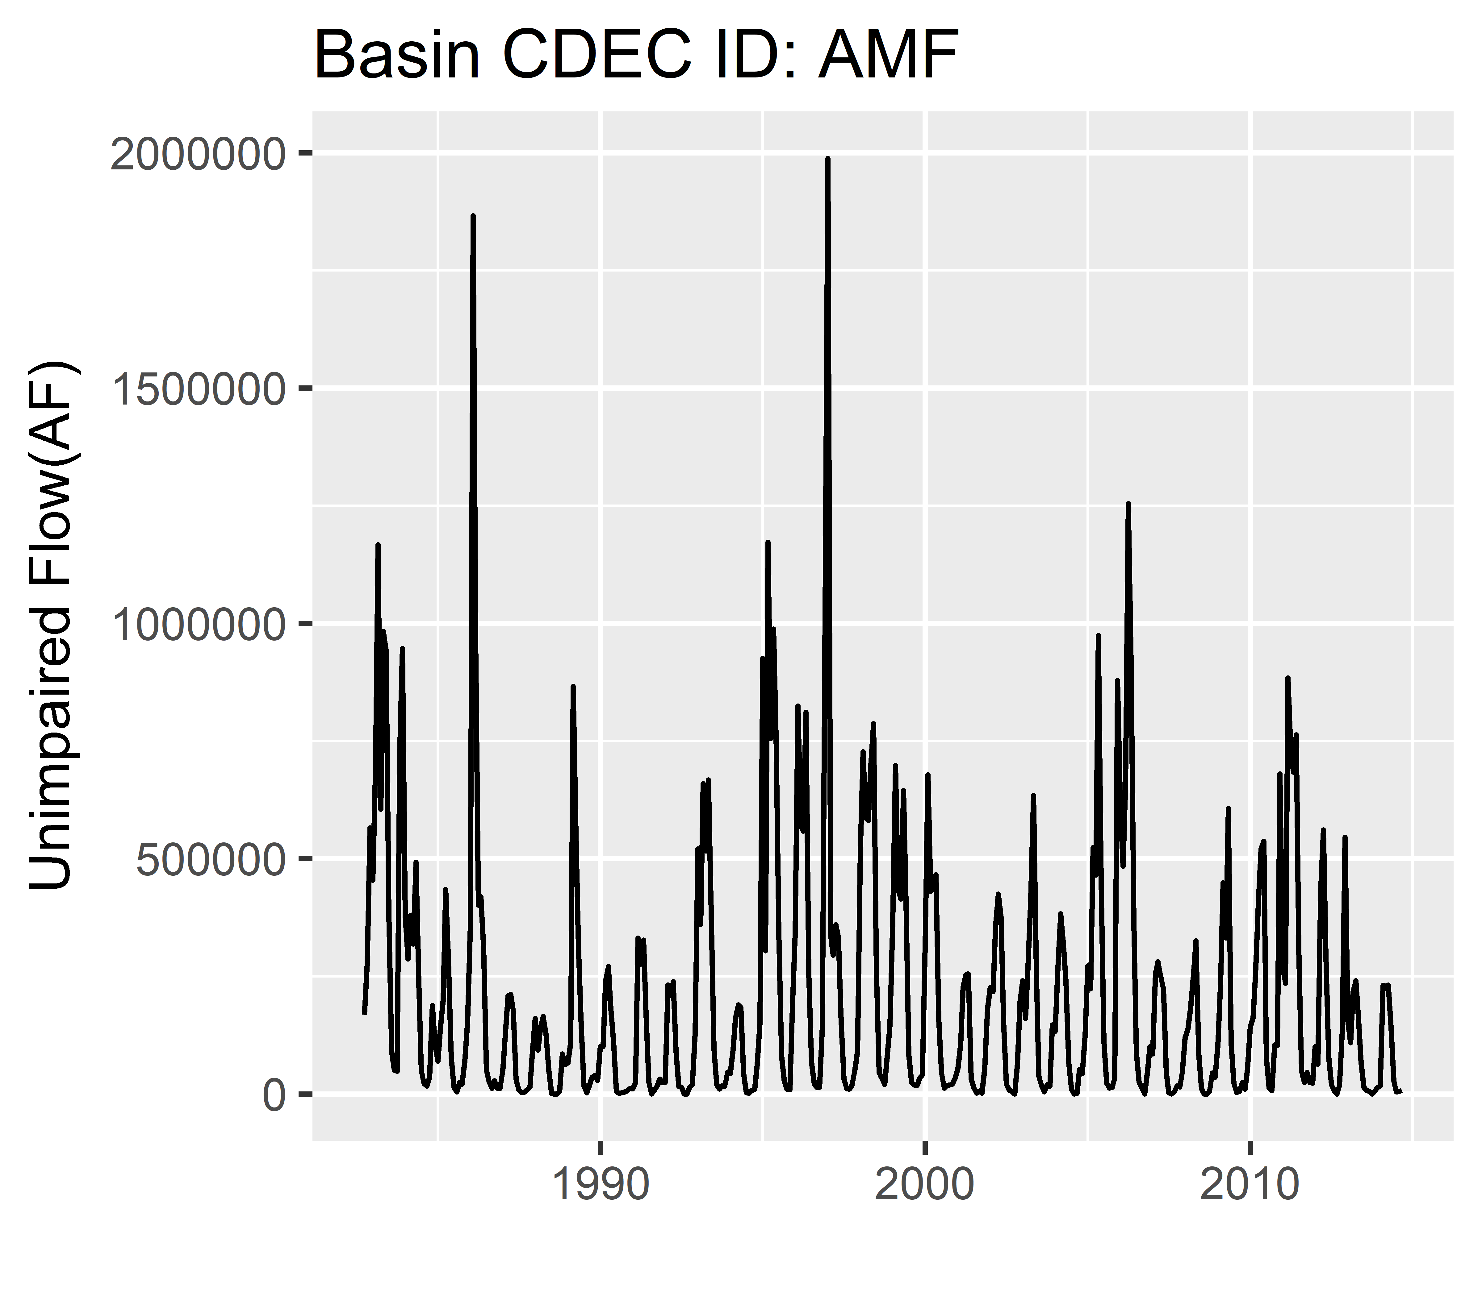
spatial
hierarchical
1
temporal
2
4
flow
time
3

Slide 11
Original Sample
Cross-Validation Splitting
Modeling
Evaluation
Input Data
- - - - - - - - - - - - - - -
Response | Predictor
Train
Model
Model Measure of Fit
Test
Prediction
Original Sample
Bootstrapped Samples
Modeling
Evaluation
Statistics (n)
Bootstrap Statistic Distribution
Statistics (n)
Statistics (n)
Statistics (n)
Input Data
- - - - - - - - - - - - - - -
Response | Predictor
Statistics (n)
Input Data
- - - - - - - - - - - - - - -
Response | Predictor
Model (n)
Statistics (n)

Slide 12



Out-of-Bag
Bag
Original Sample
Random
Resampling
$$x^{d}$$
Out-of-Bag
$$∆d$$
Bag
$$x^{d+∆d}$$
Blocked
Resampling

Slide 13
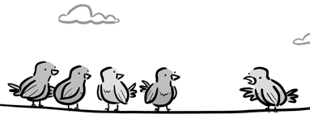
Training set
Test set

Slide 14
Simple Tools
The use of simple tools (e.g., the sickle and the plow) to make human labor more efficient, and the evolution of these tools
Animal Labor
The partial outsourcing of human labor to animals
Renewable Energy
The harvesting of renewable sources of energy (i.e., water and wind) for grain processing (e.g, milling and oil extraction)
Irrigation & Fertilizer
The control over irrigation and fertilizer, which removed the two key constraints (i.e., water and nitrogen) on crop yields
Land Use Changes
The shift to more intensive systems of land use (multicropping or in rotation), under the pressure of increasing population, leading to resiliency and higher yields
Improvement in Tools
More advancements in tools (e.g., from the 1800s to the 1900s, harvesting equipment went from sickle to cradle, binder, then combine; the plow went from wooden to cast-iron, steel, then steel gang) all increasing efficiency in human labor
Fertilizers & Pesticides
The production of fertilizers (i.e., nitrogen, phosphorus, and potassium, and later the production of synthetic nitrogenous fertilizers). Also, the use of pesticides to control disease
Solar Energy
The harvesting of another renewable source of energy (i.e., solar)
Management
Labor turning to supporting, controlling, and managing the productive process
Human Expertise
The mental development of expertise, which also requires energy inputs
Machine Expertise
The collection of data and the outsourcing of our expertise, and more to the point, our decision making, to machines

Slide 15
Capture
In the current state of the art, data is captured with sensors embedded on farm equipment and plants, unmanned aerial vehicles (UAVs), or from historical open data.
Storage
It is then stored on cloud-based platforms, Hadoop distributed file systems, or hybrid storage systems.
Transfer
It can be transferred and shared via wireless connections, cloud-based platforms, or linked open data.
Transformation & Learning
The data can then be transformed with statistical learning algorithms. It can be normalized, visualized and anonymized.
Analysis
Further analysis could bring about yield models, planning instructions, benchmarking decision ontologies, and cognitive computing.
Marketing
The final data marketing step will again visualize the data in a publicly consumable manner (Wolfert, Ge, Verdouw, & Bogaardt, 2017).

Slide 16
Input Data
- - - - - - - - - - - - - - - - -
Response | Predictor
Test
Train
ML Model
ML Prediction
Measures of Fit
Notes:
We just have to be careful: using statistical models for extrapolation involves some risk and they shouldn’t be strained too much beyond their limits.

Slide 17
Original Sample
Bootstrap Samples
Bootstrap Statistics
Input Data
- - - - - - - - - - - - - - - - -
Response | Predictor
Input Data
- - - - - - - - - - - - - - - - -
Response | Predictor
Statistics (n)
Input Data
- - - - - - - - - - - - - - - - -
Response | Predictor
Statistics (n)
Input Data
- - - - - - - - - - - - - - - - -
Response | Predictor
Statistics (n)
Input Data
- - - - - - - - - - - - - - - - -
Response | Predictor
Statistics (n)
Input Data
- - - - - - - - - - - - - - - - -
Response | Predictor
Statistics (n)
Input Data (n)
- - - - - - - - - - - - - - - - -
Response | Predictor
Statistics (n)
Bootstrap Statistic Distribution
Notes:
We just have to be careful: using statistical models for extrapolation involves some risk and they shouldn’t be strained too much beyond their limits.

Slide 18
Original Sample
Bootstrap Simulations
Model For Each Simulation
Bootstrap Statistics
Input Data
- - - - - - - - - - - - - - - - -
Response | Predictor
Input Data
- - - - - - - - - - - - - - - - -
Response | Predictor
Input Data
- - - - - - - - - - - - - - - - -
Response | Predictor
Input Data
- - - - - - - - - - - - - - - - -
Response | Predictor
Input Data
- - - - - - - - - - - - - - - - -
Response | Predictor
Input Data
- - - - - - - - - - - - - - - - -
Response | Predictor
Input Data (n)
- - - - - - - - - - - - - - - - -
Response | Predictor
Test
Train
Test
Train
Test
Train
Test
Train
Test
Train
Test
Train
ML Model (n)
ML Model (n)
ML Model (n)
ML Model (n)
ML Prediction
ML Model (n)
Statistics (n)
ML Prediction
ML Model (n)
Statistics (n)
ML Prediction
Statistics (n)
ML Prediction
Statistics (n)
ML Prediction
Statistics (n)
ML Prediction
Statistics (n)
Bootstrap Statistics Distribution
Notes:
We just have to be careful: using statistical models for extrapolation involves some risk and they shouldn’t be strained too much beyond their limits.

Slide 19
small
medium
large
block sizes
Auto Correlation
best case scenario
Data Size
Computational Ability
small
small
medium
large
Auto Correlation
Data Size
Computational Ability
medium
small
medium
large
Auto Correlation
Data Size
Computational Ability
large

Slide 20
small
medium
large
block sizes
Auto Correlation
Data Size
Computational Ability
small
small
medium
large
Auto Correlation
Data Size
Computational Ability
medium
small
medium
large
Auto Correlation
Data Size
Computational Ability
large

Slide 21
small
medium
large
block sizes
Auto Correlation
worst case scenario
Data Size
Computational Ability
small
small
medium
large
Auto Correlation
most common scenario
Data Size
Computational Ability
medium

Slide 22
Small
Medium
Large
Block Sizes
Small
Medium
Large
Block Sizes
Auto Correlation
Data Size
best case scenario
S
S
Computational Ability
Auto Correlation
Data Size
M
M
Computational Ability
Auto Correlation
Data Size
L
L
Computational Ability
Auto Correlation
most common scenario
Data Size
worst case scenario
S
M
Computational Ability

Slide 23
Small
Medium
Large
Block Sizes
Auto Correlation
Data Size
S
Computational Ability
best case scenario
Auto Correlation
Data Size
M
Computational Ability
Auto Correlation
Data Size
L
Computational Ability
Auto Correlation
Data Size
S
Computational Ability
worst case scenario
Auto Correlation
Data Size
S
Computational Ability
Auto Correlation
Data Size
M
Computational Ability
Auto Correlation
Data Size
L
Computational Ability
Auto Correlation
Data Size
M
Computational Ability
most common scenario

Slide 24
Whole dataset
Iteration 1
Iteration 2
Iteration 3
Iteration 4
Test set
Iteration 5
Training set
1 fold

Slide 25


